Slide 1

INGEGNERIA ELETTRONICA E INFORMATICA
CHET APP
Chat different

Slide 2
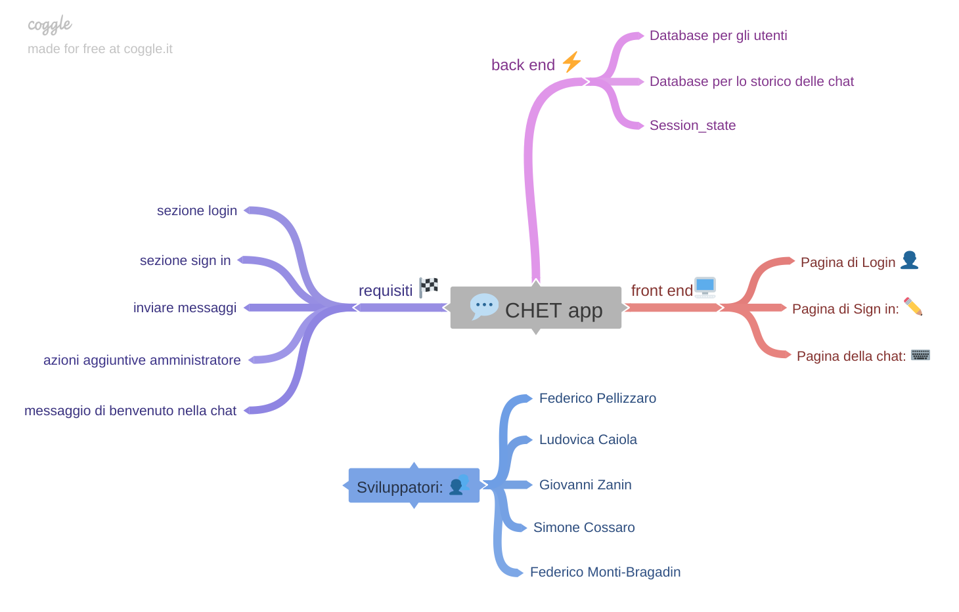
BRAINSTORMING
INGEGNERIA ELETTRONICA E INFORMATICA

Slide 3
TECHNICAL ARCHITECTURE:
INGEGNERIA ELETTRONICA E INFORMATICA
Languages: Python with Streamlit, HTML e CSS
Tools: Spyder, Atom, Github
Relational Database: Supabase
Platforms: Streamlit Cloud

Slide 4
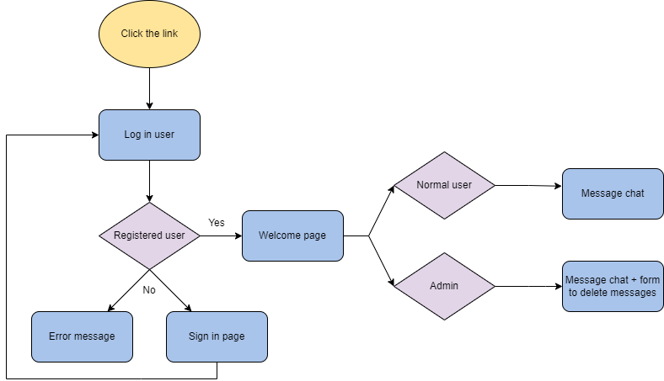
FLOW CHARTS
INGEGNERIA ELETTRONICA E INFORMATICA

Slide 5
Suddivisione ruoli:
INGEGNERIA ELETTRONICA E INFORMATICA
Federico Pellizzaro: back-end developer and HTML/CSS expert
Giovanni Zanin: back-end developer and web administrator
Ludovica Caiola: front-end developer and graphic designer
Simone Cossaro: front-end developer and graphic designer
Federico Monti-Bragadin: manager and human factor expert

Slide 6
Let’s chet! https://fedrosauro-chet-application-chet-login-c65w2j.streamlitapp.com/
INGEGNERIA ELETTRONICA E INFORMATICA

Slide 7
More in details: https://github.com/Fedrosauro/CHET-APPLICATION
INGEGNERIA ELETTRONICA E INFORMATICA

